Slide 1
WK 3 W/B 18.1.21

Slide 3
ai

Slide 4
oo

Slide 5
th

Slide 6
igh

Slide 7
ch

Slide 8
oa

Slide 9
ng

Slide 10
sh

Slide 11
ee

Slide 12
qu

Slide 13
ow

Slide 14
ur

Slide 15
oo

Slide 16
er

Slide 17
or

Slide 18
air

Slide 19
ar

Slide 20
oi

Slide 21
ure

Slide 22
ay

Slide 23
a_e

Slide 24
ie

Slide 25
ea

Slide 26
ou

Slide 27
ir

Slide 28
aw

Slide 29
u_e

Slide 30
o_e

Slide 31
oy

Slide 32
oe

Slide 33
i_e

Slide 34
ear

Slide 35
ue

Slide 36
ph

Slide 37
au

Slide 38
wh

Slide 39
e_e

Slide 40
ew

Slide 41
Monday

Slide 42
‘ee’ sound family
ee
eel
sheep
ea
cream
bean
e
emu
hero
e_e
these
here

Slide 43
heel steel free

Slide 44
seat cream seal

Slide 45
here Pete these

Slide 46
evil emu hero

Slide 47
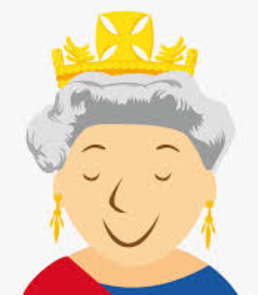
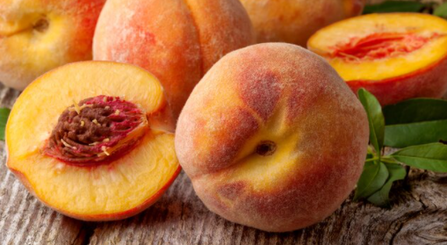

Slide 48
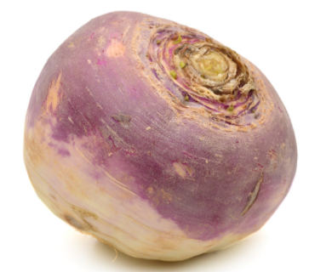
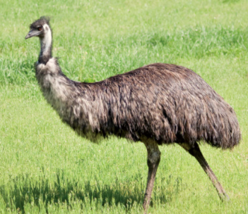

Slide 49
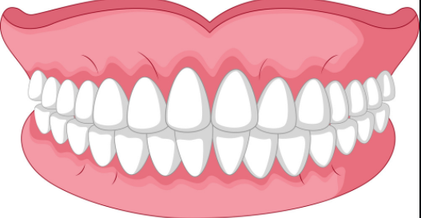
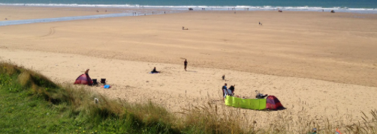

Slide 50
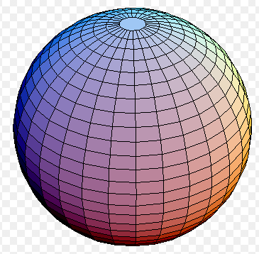

Slide 51
He ran into the deep freezing sea
She had a dream about magic green beans that made him scream.

Slide 52
Tuesday

Slide 53
sphere here theme

Slide 54
eel wheel meet

Slide 55
treat dream meal

Slide 56
equal me we

Slide 57
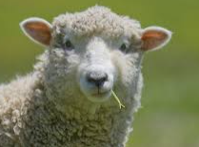

Slide 58
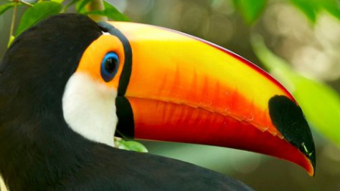
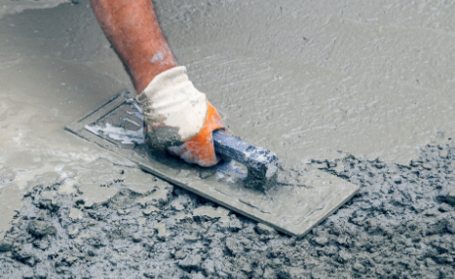

Slide 59
The evil sheep went into the green sea.
The beast was a hero when he ate a feast of green beans.

Slide 60
I can read and sort graphemes from the ee family
ee | ea | e_e | e
feet | mean | here | emu

Slide 61
Wednesday

Slide 62
he

Slide 63
she

Slide 64
me

Slide 65
we

Slide 66
be

Slide 67
he

Slide 68
you

Slide 69
are

Slide 70
was

Slide 71
they

Slide 72
all

Slide 73
my

Slide 74
her

Slide 75
said

Slide 76
come

Slide 77
some

Slide 78
like

Slide 79
little

Slide 80
have

Slide 81
so

Slide 82
do

Slide 83
out

Slide 84
one

Slide 85
there

Slide 86
were

Slide 87
when

Slide 88
what

Slide 89
oh

Slide 90
could

Slide 91
would

Slide 92
should

Slide 93
their

Slide 94
people

Slide 95
asked

Slide 96
looked

Slide 97
called

Slide 98
Thursday

Slide 99
‘ee’ sound family
ee
eel
sheep
ea
cream
bean
e
emu
hero
e_e
these
here
Today’s new graphemes
ey
key
honey
y
puppy
sunny

Slide 100
lucky sunny baby

Slide 101
donkey turkey trolley

Slide 102
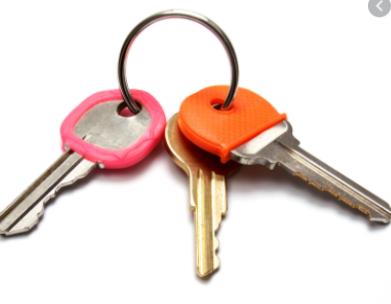
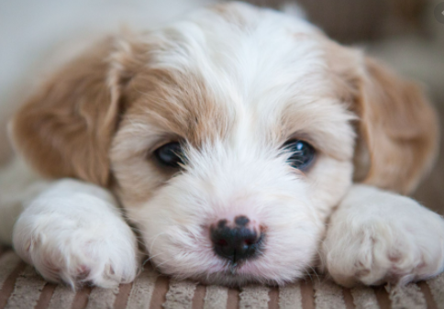

Slide 103
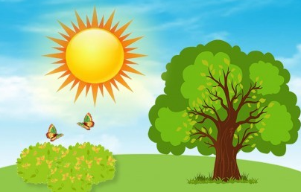
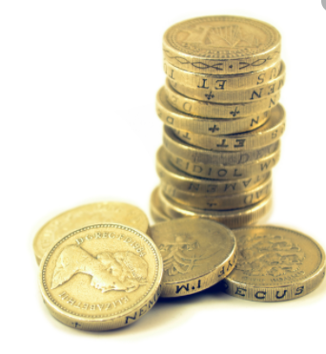

Slide 104
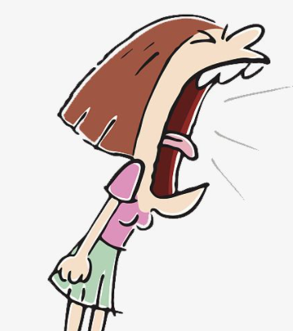
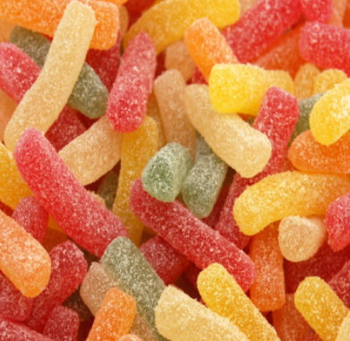

Slide 105
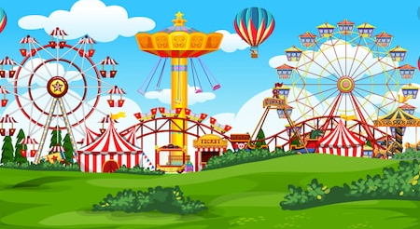

Slide 106
Is the key near the puppy?
Can the donkey eat the honey on a sunny day?

Slide 107
Friday

Slide 108
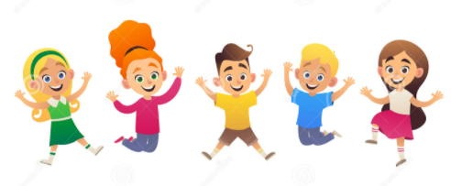
Fun phonics Friday

