Slide 1
W/B 18.1.21 Good Morning Venus Class

Slide 3
ng

Slide 4
ai

Slide 5
ee

Slide 6
oo

Slide 7
th

Slide 8
ch

Slide 9
oa

Slide 10
sh

Slide 11
igh

Slide 12
qu

Slide 13
ow

Slide 14
oo

Slide 15
er

Slide 16
ur

Slide 17
or

Slide 18
ar

Slide 19
ure

Slide 20
oi

Slide 21
ay

Slide 22
ie

Slide 23
a_e

Slide 24
ea

Slide 25
air

Slide 26
ou

Slide 27
aw

Slide 28
ir

Slide 29
u_e

Slide 30
o_e

Slide 31
oy

Slide 32
oe

Slide 33
ear

Slide 34
ue

Slide 35
au

Slide 36
wh

Slide 37
ph

Slide 38
e_e

Slide 39
ew

Slide 40
i_e

Slide 41
Monday

Slide 42
drain mail paint

Slide 43
play spray tray

Slide 44
cake rake make

Slide 45
acorn table apron

Slide 46
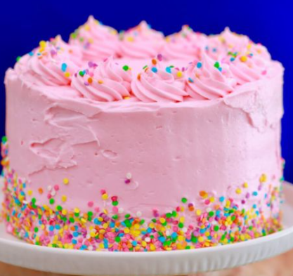
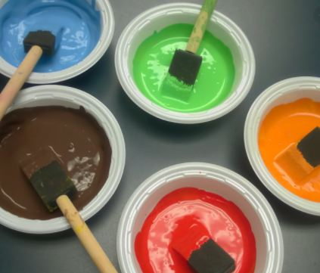

Slide 47
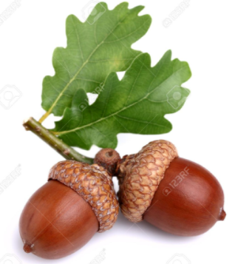
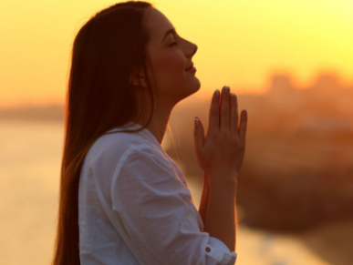

Slide 48
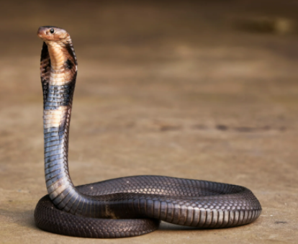
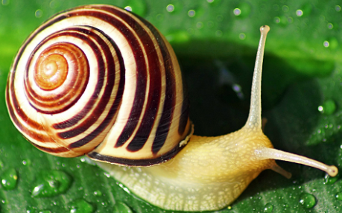

Slide 49
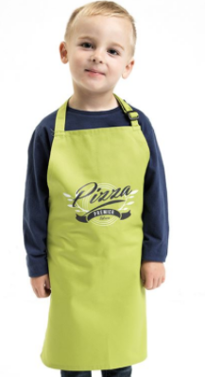
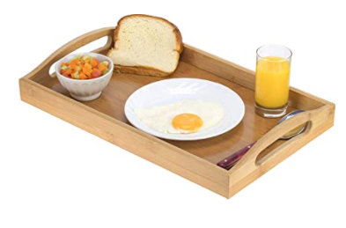

Slide 50
Can snails play with cake?
A lady is on train with a snail going on holiday.

Slide 51
I can read and sort graphemes from the ai family
ai | ay | a_e | a
rain | pay | lake | acorn

Slide 52
Tuesday

Slide 53
he

Slide 54
she

Slide 55
me

Slide 56
we

Slide 57
be

Slide 58
he

Slide 59
you

Slide 60
are

Slide 61
was

Slide 62
they

Slide 63
all

Slide 64
my

Slide 65
her

Slide 66
said

Slide 67
come

Slide 68
some

Slide 69
like

Slide 70
little

Slide 71
have

Slide 72
so

Slide 73
do

Slide 74
out

Slide 75
one

Slide 76
there

Slide 77
were

Slide 78
when

Slide 79
what

Slide 80
oh

Slide 81
could

Slide 82
would

Slide 83
should

Slide 84
their

Slide 85
people

Slide 86
asked

Slide 87
looked

Slide 88
called

Slide 89
Today’s Tricky Words

Slide 90
said like do come there

Slide 91
Wednesday

Slide 92
eight weigh sleigh

Slide 93
break steak great

Slide 94
Thursday

Slide 95
straight

Slide 96
sundae

Slide 97
Friday

Slide 98
pray today clay

Slide 99
brain snail pain

Slide 100
angel apricot April

Slide 101
drain mail paint

Slide 102
space spade shake

Slide 103
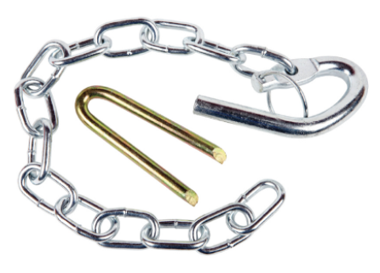
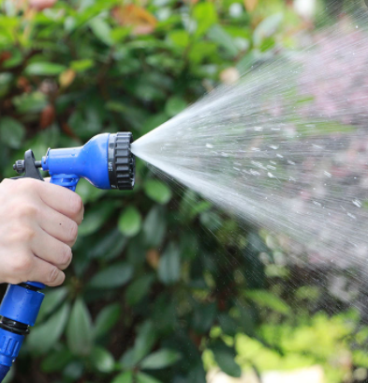
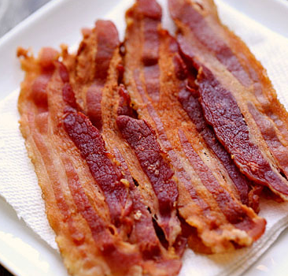

Slide 104
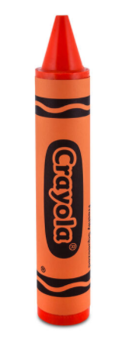
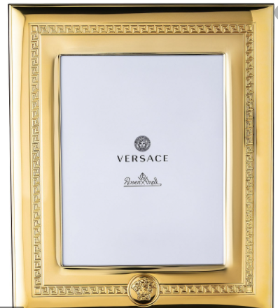
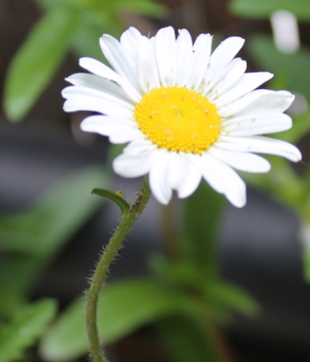

Slide 105
Is the cake on the table?
Can the angel play with the snail in the lake?

