Slide 1
W/B 1.2.21 Good Morning Venus Class

Slide 3
th

Slide 4
ai

Slide 5
igh

Slide 6
oa

Slide 7
ch

Slide 8
ng

Slide 9
oo

Slide 10
ee

Slide 11
sh

Slide 12
qu

Slide 13
ur

Slide 14
ow

Slide 15
er

Slide 16
oo

Slide 17
air

Slide 18
or

Slide 19
ar

Slide 20
oi

Slide 21
ure

Slide 22
a_e

Slide 23
ie

Slide 24
ea

Slide 25
ou

Slide 26
ir

Slide 27
ay

Slide 28
aw

Slide 29
u_e

Slide 30
oy

Slide 31
o_e

Slide 32
i_e

Slide 33
oe

Slide 34
ear

Slide 35
ph

Slide 36
ue

Slide 37
au

Slide 38
wh

Slide 39
ew

Slide 40
e_e

Slide 41
Monday

Slide 42
‘igh’ sound family
igh
light
night
ie
tie
pie
i
find
mind
child
i_e
slide
bike

Slide 43
light high fright

Slide 44
pie tie cried

Slide 45
slide bike five

Slide 46
find mind child

Slide 47
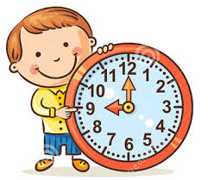

Slide 48
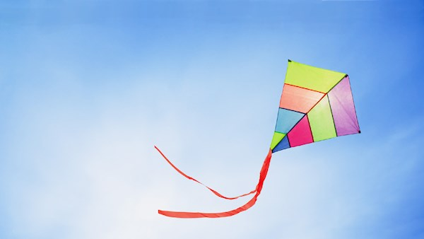

Slide 49
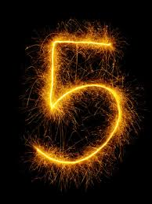
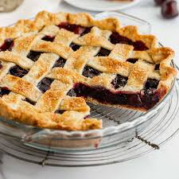

Slide 50
The light is bright in the sky.
She had a dream to find and eat a bright pink pie.

Slide 51
Tuesday

Slide 52
he

Slide 53
she

Slide 54
me

Slide 55
we

Slide 56
be

Slide 57
he

Slide 58
you

Slide 59
are

Slide 60
was

Slide 61
they

Slide 62
all

Slide 63
my

Slide 64
her

Slide 65
said

Slide 66
come

Slide 67
some

Slide 68
like

Slide 69
little

Slide 70
have

Slide 71
so

Slide 72
do

Slide 73
out

Slide 74
one

Slide 75
there

Slide 76
were

Slide 77
what

Slide 78
when

Slide 79
oh

Slide 80
could

Slide 81
would

Slide 82
should

Slide 83
their

Slide 84
people

Slide 85
called

Slide 86
asked

Slide 87
looked

Slide 88
Todays words

Slide 89
would

Slide 90
could

Slide 91
should

Slide 92
Wednesday

Slide 93
I can read and sort graphemes from the igh family
igh | ie | i_e | i
night | cries | time | child
Use the sheet on our class page to be a word sorter.

Slide 94
slide time prize

Slide 95
lie untie fried

Slide 96
high sigh fight

Slide 99
Can you come up with your own sentences using the different igh sounds?
Challenge: Can you think of a sentence using ALL the different igh sounds you know so far?

Slide 100
Thursday

Slide 101
‘igh’ sound family
igh
light
night
ie
tie
pie
i
find
mind
child
i_e
slide
bike
Today’s new grapheme
y
dry
sky

Slide 102
dry cry fly

Slide 104
Can a spy fry an egg?
Can a fly eat honey on a bright day?

Slide 105
Friday

Slide 106
Today I would like you to recap all the different igh sounds from this week.

Slide 107
‘igh’ sound family
igh
light
night
ie
tie
pie
i
find
mind
child
i_e
slide
bike
y
dry
sky

Slide 108
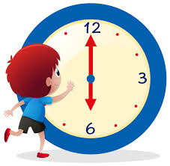

Slide 109
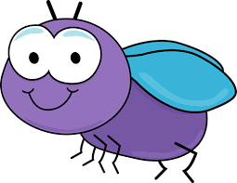

Slide 110
